Slide 1

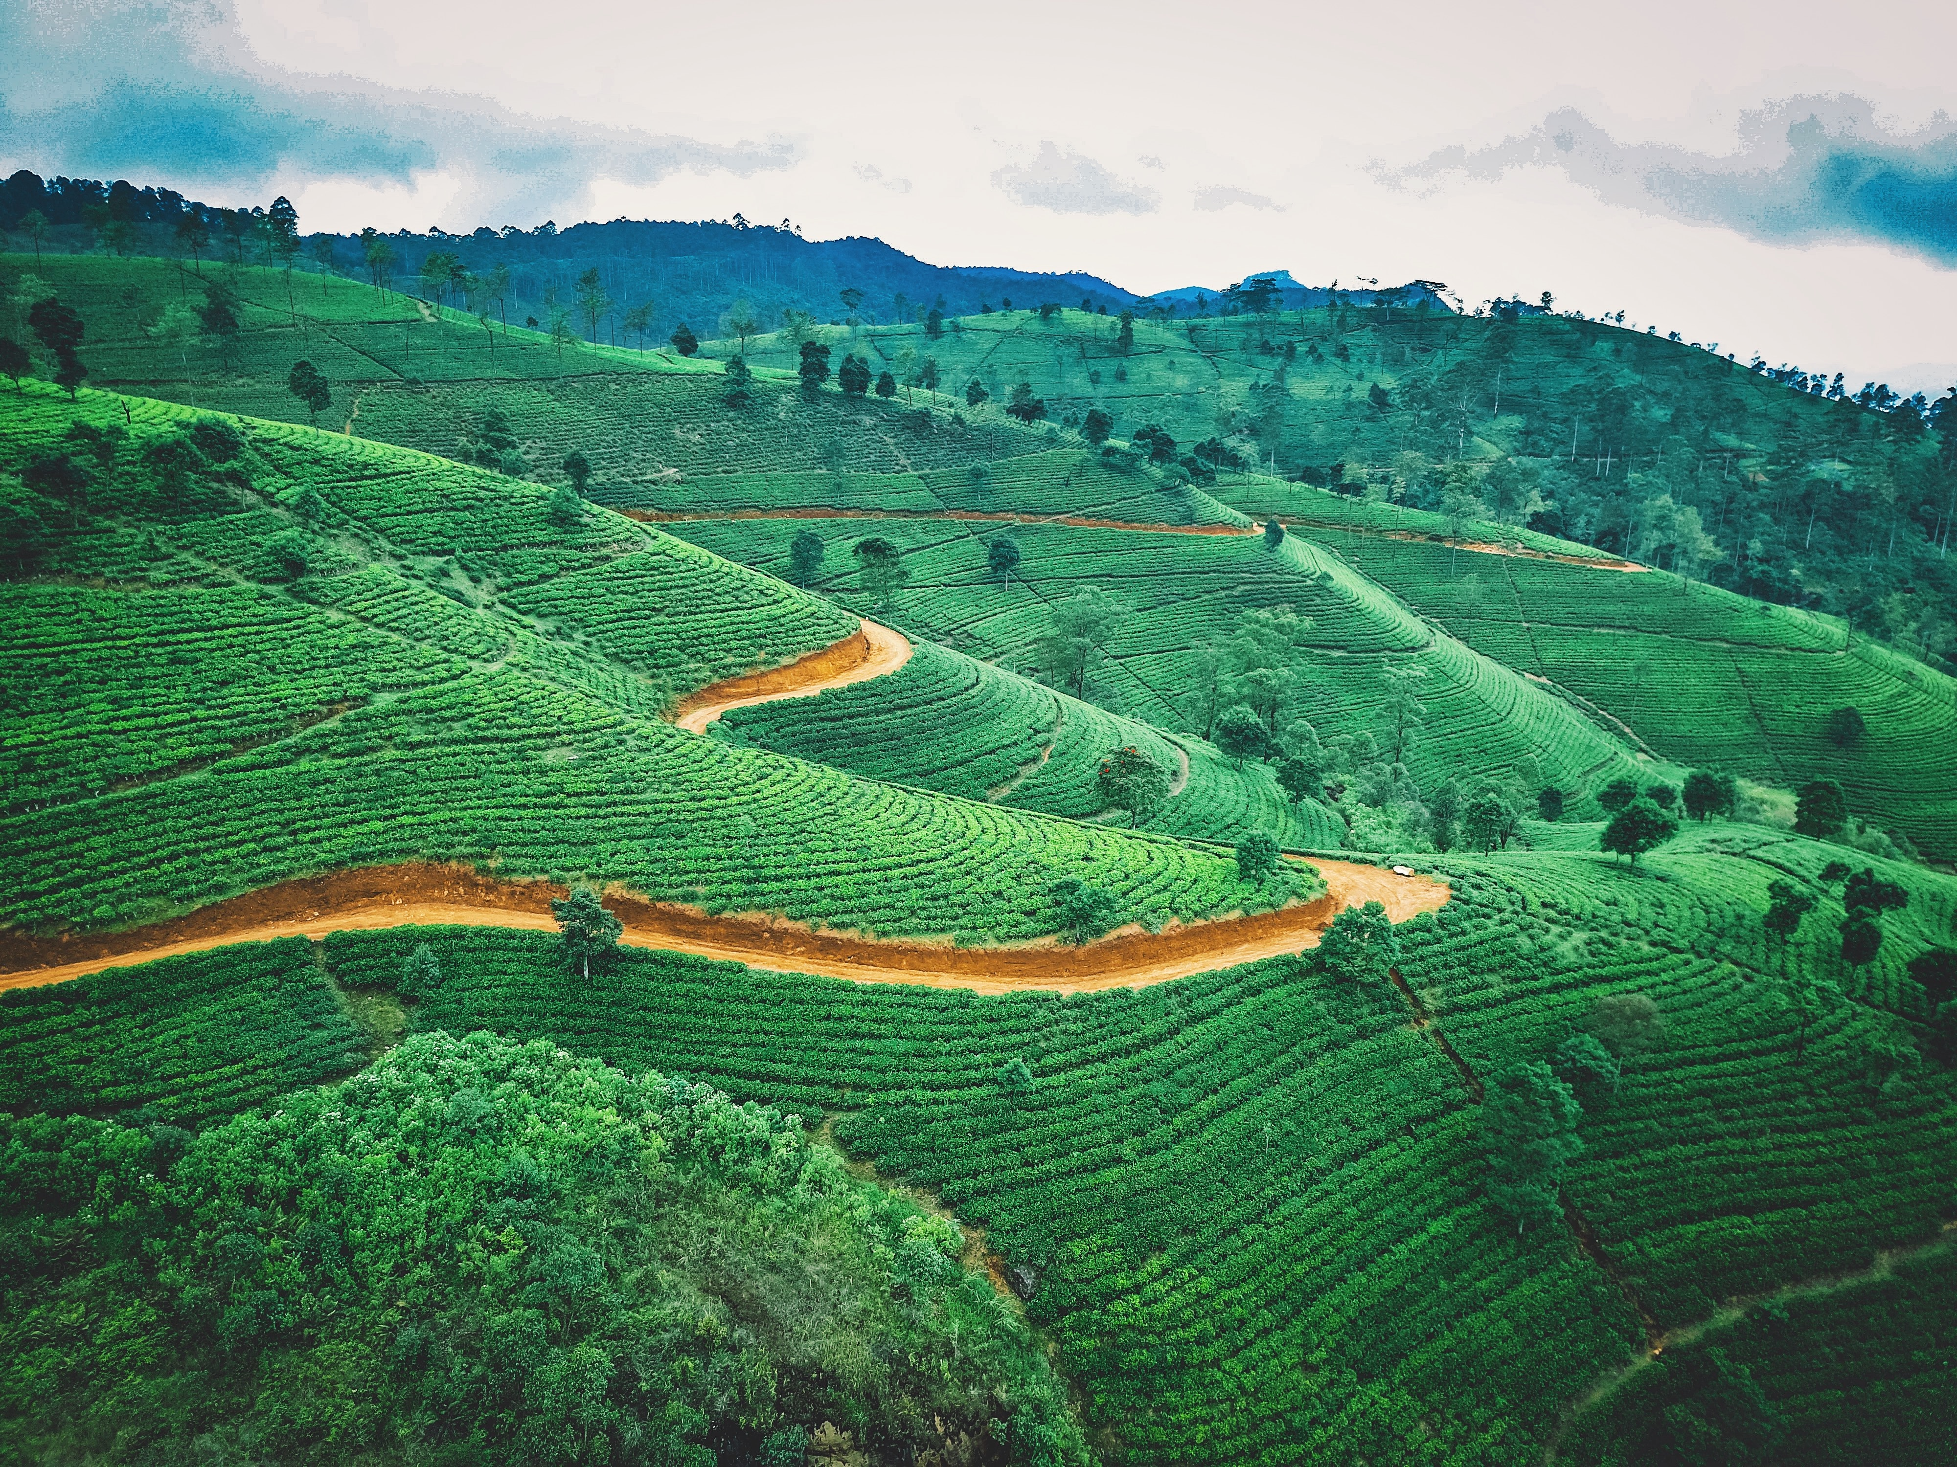
Educational tour to Shri Lanka
mobile No.: +91-9860237191, Email-id:redwoodedtours@gmail.com

Slide 2
content
About Us
About Destination
The Tour Aims & Benefits
facts about shri lanka
Complete Itinerary
Services included

Slide 3
About us
Our
Experience
Over 10 years experience in the educational travel industry with over 10,000 students traveling with us every year
We provide safe, high-quality, competitively priced tours that support classroom learning and we’re here to help group leaders tackle all the practicalities of taking a group away
Our
Protection
We share your passion for your subject. Most of us at Redwood are experts in one or more subject fields, fluent in more than one language and have travelled extensively
This mix of on-the-ground knowledge and subject expertise means we know how to make the most out of every step of your school trip
Part of TUI Travel PLC, we offer the highest level of financial protection. TUI’s global presence ensures that we have a year-round worldwide support network
We are proud to have been awarded full accreditation for the LOtC Quality Badge scheme, are a full member of the School Travel Forum and fully bonded by ABTA and ATOL
Our
Protection

Slide 4
content
About Us
About Destination
Tour Aims & Benefits
Facts about shri lanka
Complete Itinerary
Services included

Slide 5
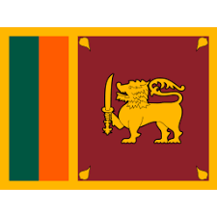
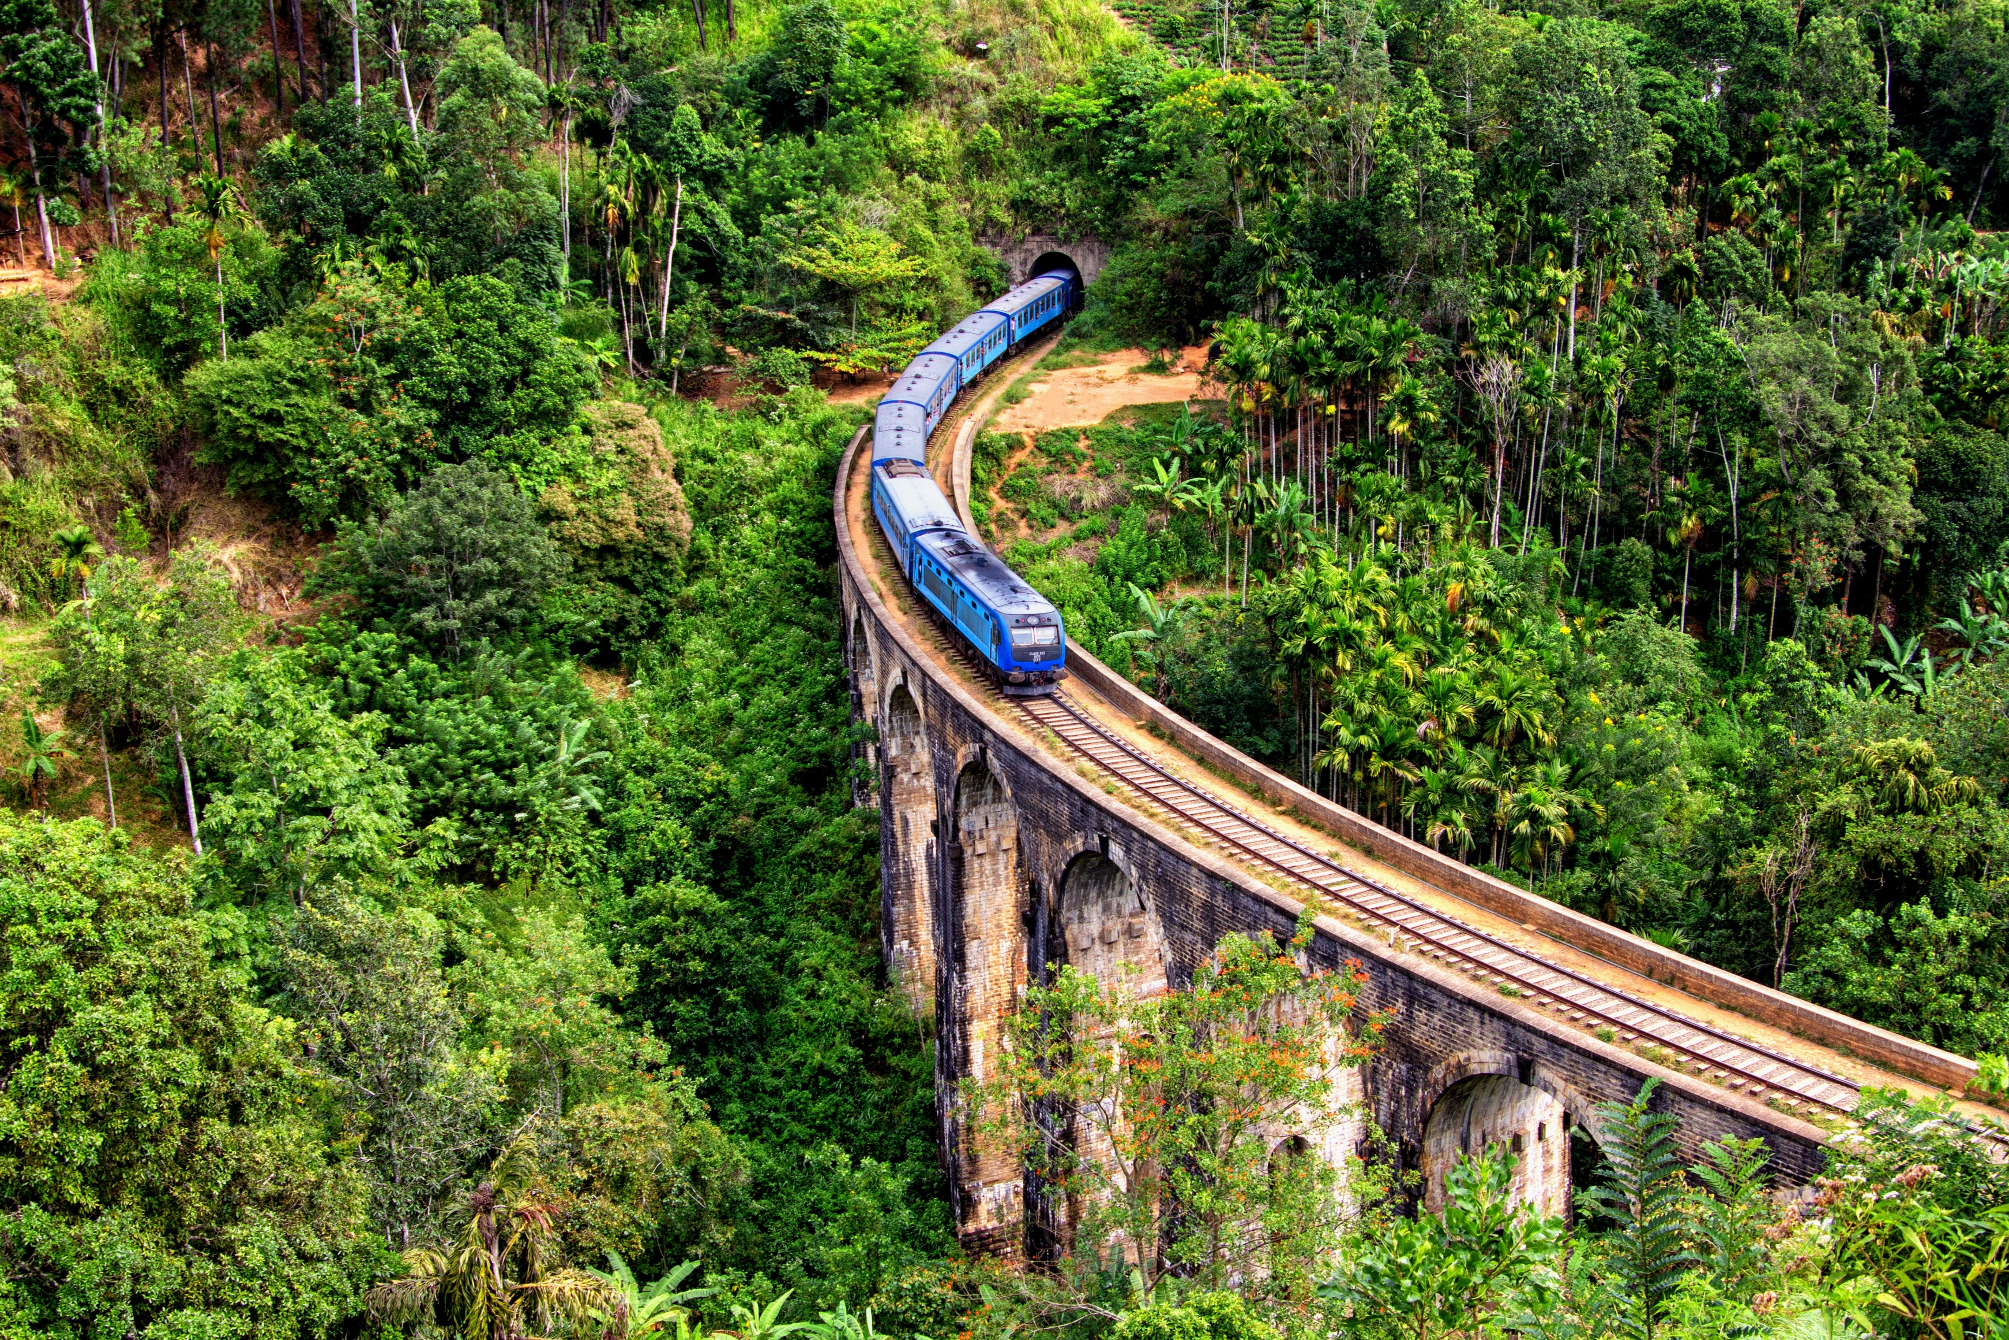
About Destination
n
Elle in Shri Lanka
Information about Shri lanka :
Currency:Sri Lankan rupee
Language: Sinhala, Tamil
Population:2.14 crores
Sri Lanka is an island country in South Asia, located in the Indian Ocean to the southwest of the Bay of Bengal and to the southeast of the Arabian Sea.
The island is geographically separated from the Indian subcontinent by the Gulf of Mannar and the Palk Strait.
The legislative capital, Sri Jayawardenepura Kotte, is a suburb of the commercial capital and largest city, Colombo.
Other interesting facts about Shri Lanka:
the island has a teardrop shape and is off the coast of India, which is easier to see from the map. That’s why it is also called teardrop of India.
The people of Sri Lanka through generations believed that king Ravana ruled this country. There are many sites in Sri Lanka which are connected to the Ramayana.

Slide 6
content
About Us
About Destination
Tour Aims & Benefits
Facts about Shri Lanka
Complete Itinerary
Services included

Slide 7
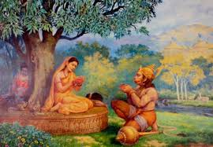
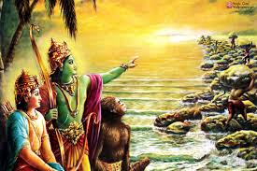
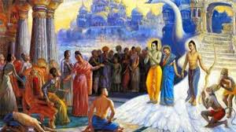
Aims & Benefits
Why Shri Lanka?
The Ramayana is an ancient Sanskrit epic attributed to the poet Valmiki and an important part of the Hindu canon. One of the most important literary works of ancient India, the Ramayana consists of 7 chapters (Kānda), and narrates the story of Rama’s wife Sita being abducted by Rāvana, the demon (Rākshasa) king of Lanka. The Ramayana begins with Ayodhya in India and climaxes at Lankapura (Sri Lanka).
Ramayana has fascinated many generations, and had a profound impact on art and culture in the Indian subcontinent and Southeast Asia. Sri Lanka shares a special bond with India geographically, historically, culturally and spiritually – The Ramayana is one such link.

Slide 8
Benefits
What do you remember from school? What caused you to be who you are today? Chances are, a group project, a special speaker, or a field trip helped you decide. It may have even been something you did on your own, outside of school after learning about a given topic. There was something in your life that sparked your passion or curiosity. It pushed you to take your learning into your own hands and learn more.
Every student comes to the classroom with a different world experience. We know that students who have been exposed to many different things do better in school. In order to be successful readers, students need to relate what they read to what they've experienced. To think broadly students need to have a variety of experiences.
Real World Learning: As teachers, educational tour is one of the best tools that we can use to provide every student with real-world experiences. Whether that's a trip to the local grocery store, waterfront park, a library, a museum, a theater, a community garden or a restaurant, each experience that a student participates in contributes to their understanding of the world.
Socio-emotional Growth:Students who go on educational tours become more empathetic and tolerant. A study conducted by the various State Board, CBSE Board found that students that participate in a field trip to an art museum show increased empathy, tolerance and critical thinking skills. Studying art gives students a chance to think about a topic or theme from a different perspective.
Academic Impact: This educational tour to Shri Lanka will give hands on learning & make concepts more memorable. Just think back to what you learned in school, the field trips you took, and what you learned on them are still some of the clearest concepts.

Slide 9
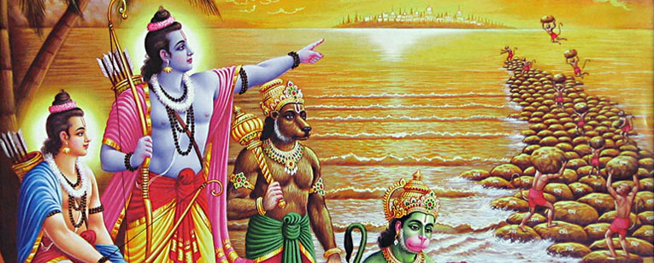
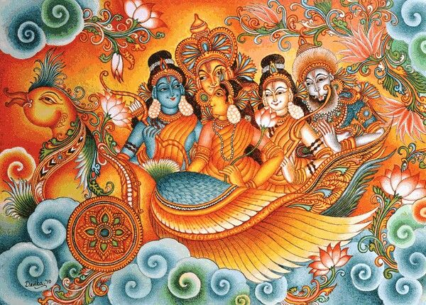
What you get?
The great Hindu epic Ramayana, tells of the conquest of Sri Lanka in 3000 BC by the Hindu god “Rama” who fought with the demon king “Ravana” in Sri Lanka to rescue his wife “Sita”. Today Sri Lanka offers the opportunity to visit the many sites believed to have been part of the great Ramayana which include amongst others, Ravana’s fort, the Sita Amman temple where Sita was held and the Ritgala medicinal forest amongst others.
Sri Lanka is the proud custodian of more than 50 Ramayana sites from the place of Seetha Devi’s captivity to the battlefields where vast armies clashed, to the groves of exotic herbs dropped by the monkey god Hanuman, to the ultimate theatre of war where Lord Rama slew Ravana, the ten-headed demon-king.
Incredibly, the names of places have come down to modern times unchanged. Though great social, cultural and religious changes have taken place in Sri Lanka since.
Get involved in the day-to-day functioning of a people in shri lanka, and gain an appreciation of the challenges involved in education delivery.
Compare and evaluate the contrasts in language, lifestyle, culture, and traditions of your hometown with those of villages in Shri lanka to build unique perspectives

Slide 10
content
About Us
About Destination
Tour Aims & Benefits
Facts about Shri Lanka
Complete Itinerary
Services included

Slide 11
Facts of Shri Lanka
Sri Lanka only covers an area of 25,332 mi², which is just slightly larger than the US state of West Virginia. However, its wildlife is incredibly diverse. It's home to 123 species of mammals (such as elephants, leopards, and crocodiles), 227 species of birds, 178 species of reptiles, 122 species of amphibians, and many other animal species.
Ceylon Tea Museum situated just 4 km south of Kandy. It is an ideal place to enjoy a nice cuppa and learn about the history of tea in Sri Lanka. You'll find the exhibits of tea pioneers like James Taylor and Thomas Lipton who had helped make tea part of daily life in the UK. Sri Lanka is famous for its cinnamon, an indispensable ingredient for many of its fabulous food.
A sacred tooth relic of Lord Buddha, brought from India in the 4th century CE, is still preserved in the Temple of the Tooth in Kandy. Every summer, there's a grand festival known as Esala Perahera (Festival of the Tooth), one of Sri Lanka's 7 best festivals, to honor the tooth.

Slide 12
content
About Us
About Destination
The Tour Aims & Benefits
Facts about Shri Lanka
Complete Itinerary
Services included

Slide 13
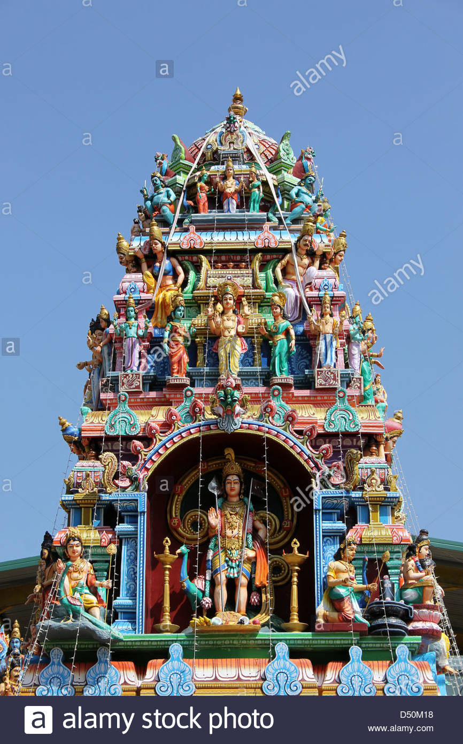
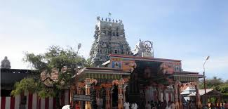
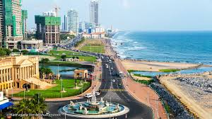
Day 1
Arrival in Colombo
On the first day of your Ramayana tour, you will be received at Colombo International Airport from where you will be escorted to Kandy.
On the way, visit the significant Munneswaram Hindu Temple -- one of the five ancient temples of Lord Shiva in Sri Lanka. Next, you will visit the Manavari temple. The temple is considered as the first lingam installed and worshipped by Lord Rama and is also known as Ramalinga Shivan. After a journey of three hours, you will reach Kandy. Check-in at the hotel and stay for the night.
Distance from Colombo to Kandy: 133 km
Travel time (Colombo to Kandy):Approx. 3 hours
Manavari temple
Munneswaram Temple
Colombo

Slide 14
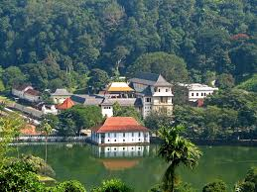
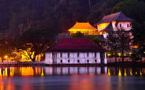
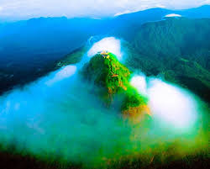
Day 2
Exploring Kandy
Post a scrumptious breakfast, get ready for the religious city tour of Kandy. The first attraction that you will be visiting is the shimmering Kandy Lake where you can sit in peace for some time. Next, you explore the nearby Market Square.
Sanjeevni mountain finds mention in the epic of Ramayana. One of its peak was carried by Lord Hanuman when Laxman was rendered unconscious by Meghnad in the war against Lanka. This mountain is said to have magical herbs that could cure any disease.
Lastly, you will explore the Sacred Temple of Tooth Relic where the relic of the tooth of the Buddha has been enshrined. After a successful day, come back to the hotel and stay for the night.
Kandy city
Sanjeevani parvat

Slide 15
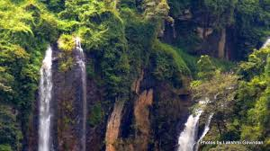
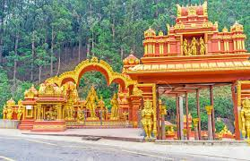
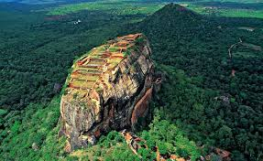
Day 3
Transfers from Kandy to Nuwara Eliya
Begin the day on a healthy note with a hearty breakfast. Check-out from the hotel and proceed to the picturesque Nuwara Eliya,the City of Lights, is a resort city in the Central Mountain range of Sri Lanka.
En route visit the ancient Sri Baktha Hanuman Temple, situated on the hills of Ramboda. The temple was built by Chinmaya Mission on the hills where Lord Hanuman is believed to have begun the search mission for Goddess Sita.
Seetha Amman Temple, which is known as Ashoka Vatika -- where Goddess Sita was believed to be kept. Check-in at the hotel in Nuwara Eliya and enjoy a goodnight’s sleep.
Distance from Kandy to Nuwara Eliya: 133 km
Travel time (Kandy to Nuwara Eliya): 3 hours
Ramboda waterfall
Amma temple
Ashoka Vatika

Slide 16
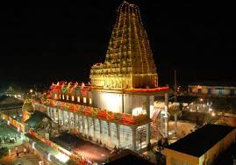
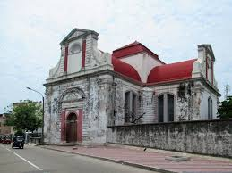
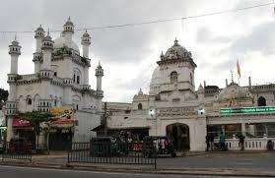
Day 4
Travel to Colombo
After a nutritious breakfast, check-out from the hotel to be transferred to the capital city of Sri Lanka, Colombo for an enriching city tour. Upon reaching Colombo, check-in at the hotel and relax for some time.
Later, visit Panchamuga Anjaneyar Temple. It is the only temple in the world to have a chariot of Anjaneyar. The city tour of Colombo includes the visit to former British administrative center, the buzzing Sea Street and the nearby markets where a sacred Hindu Temple is located. Also, explore the Dutch Church of Wolfendhal and the historic Dewatagaha Mosque.
Lastly, you can see the replica of Avukana Buddha at the BMICH and the Independence Square. Return to the hotel and enjoy a comfortable overnight stay.
After all ready to be transferred to the international airport to fly back to India after an enlightening Ramayana tour of Sri Lanka.
Panchamunga Anjaneyar
Wolfendhal church
Dewatangaha Mosque

Slide 17
content
About Us
About Destination
The Tour Aims & Benefits
Facts about Shri Lanka
Complete Itinerary
Services Included

Slide 18






Services Included
Air/ Ground Tickets
Accommodation
Regional style meal
Guided sightseeing
Full time tour director
Entrances fees
Travel Insurances

Slide 19
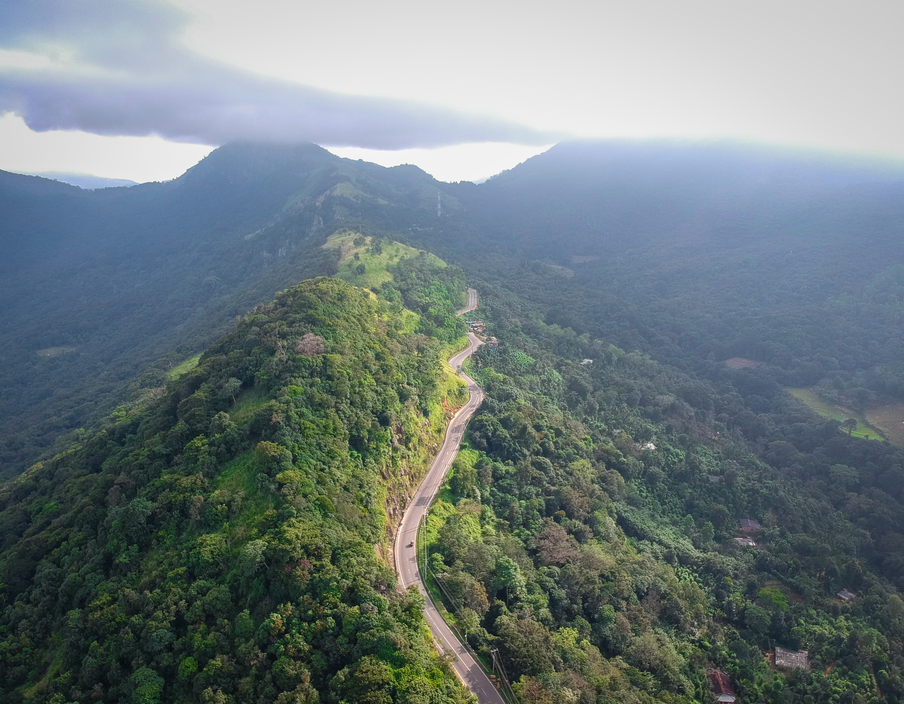
Thank You!
Enjoy Your Trip…

